Slide 1


Front End Engineering II
PROJECT GROUP 10
Semester III
(Batch 2023)
DHANADHYAKSH
Your Personal Guide To Financial Freedom
Submitted By:
Krishan Kumar Sah, 2310990467
Aadi Attrey, 2310991753
Adish Jain, 2310991761
Armaanpeet Singh, 2310991788
Supervised By:
Faculty Name:
Thirupathy M
Department Of Computer Science And Engineering
Chitkara University Institute Of Engineering & Technology
Chitkara University, Punjab

Slide 2
Dhanadhyaksh
Your Personal Guide to Financial freedom

Slide 3


Contents
Abstract
Introduction
Problem Statement
Problem Requirements
Market Competitors
Results
timeline
References

Slide 4

Abstract
Dhanadhyaksh is a comprehensive personal finance tracker designed to empower users in managing their wealth efficiently. Inspired by the Sanskrit word for "Lord of Wealth," the platform blends traditional values with modern financial management tools. It offers a user-friendly interface to track income, expenses, savings, investments, and debts, all in one place. Key features include budget planning, financial goal setting, automated insights, and detailed analytics that provide clear visibility into spending habits and growth opportunities . Dhanadhyaksh is ideal for individuals seeking a holistic approach to wealth management with culturally resonant branding.

Slide 5
Abstract
A finance tracker website offers a modern, user-friendly solution by providing automated tracking, real-time updates, and insightful analytics that empower users to take control of their finances. With features like budget planning, expense categorization, investment tracking, and goal setting, a finance tracker website helps users optimize their financial management, leading to smarter financial decisions, better savings, and ultimately, greater financial security.

Slide 6

Abstract
So here we present
DHANADHYAKSH
We are all teaming up to work on a web-project based on HTML, CSS, JavaScript and ReactJS.
Your Personal Guide To Financial Freedom

Slide 7
IntroDucTion
We have already explained you what is in the making and how we are going to achieve that.
We have divided our task in three parts:
1. Implementing HTML, CSS and little bit of JavaScript in the first model, which will lay the foundation of our project.
2.Next, we plan to implement live user interactions with the website by the help of advance JavaScript tools so as to ensure a great user-experience.
3. Last, but not the least, we intend to add React JS in our website as React uses a virtual DOM to optimize updates and rendering.

Slide 8
Problem Statement
The need for a finance tracker website

Slide 9
Problem Statement
In today's fast-paced digital world, individuals and businesses alike face increasing challenges in managing their finances effectively. Many struggle with tracking income, expenses, investments, and financial goals due to a lack of organized tools. The complexity of financial management often leads to missed payment deadlines, unplanned spending, inadequate savings, and poor investment decisions, which can result in financial instability and stress.
Traditional methods of financial management, such as manual spreadsheets or relying solely on bank statements, are time-consuming, error-prone, and do not provide real-time insights or comprehensive overviews of one's financial health. This makes it difficult for users to make informed financial decisions, achieve their financial goals, and maintain a clear understanding of their financial status.
REQUIREMENTS

Slide 10
Problem requirements

Slide 11
Problem requirements
"Dhanadhyaksh" is a name that evokes a sense of wealth management and financial stewardship, derived from Hindu mythology, particularly associated with the treasurer of the gods, Kuber. This name is fitting for a personal finance tracker website that aims to help users manage their finances effectively. Till now, we have covered
Login Page (Partial, via HTML and CSS only)
• Login Authentication
• Sign-up feature for new fellows
• Forget Password
2. Landing Page
• Brief Description of our site
• User-friendly Interface
• Book a Demo

Slide 12
Problem requirements
Technologies Used:
o HTML
o CSS
o JavaScript
o Locomotive Scroll for Smooth Interface
o Canvas For Designing and Animations
o Scroll Trigger and GSAP for Animation

Slide 13
Market competitors
COMPETITORS | STRENGTHS | WEAKNESSES | ADVANTAGES OF DHANADHAYAKSH OVER THEM
MINT | Comprehensive financial Planning, Bill tracking, and credit score monitoring. | Can be overwhelming with features, less focus on user experience | More user-friendly interface with simpler navigation and focused feature set.
YNAB | Strong budgeting philosophy and proactive financial management. | Requires a mindset shift, which can be challenging for new users. | Easier onboarding process and more intuitive for beginners
POCKET GUARD | Simplifies budget management by focusing on disposable income. | It has Limited features as compared to other comprehensive finance apps. | Offers more detailed insights and a wider range of features while maintaining simplicity
PERSONAL CAPITAL | Combines budgeting with investment tracking. | Primarily focused on wealth management, which might not appeal to all users. | Tailored for everyday users, not just those with significant investments.

Slide 14


Slide 15
results

Slide 16
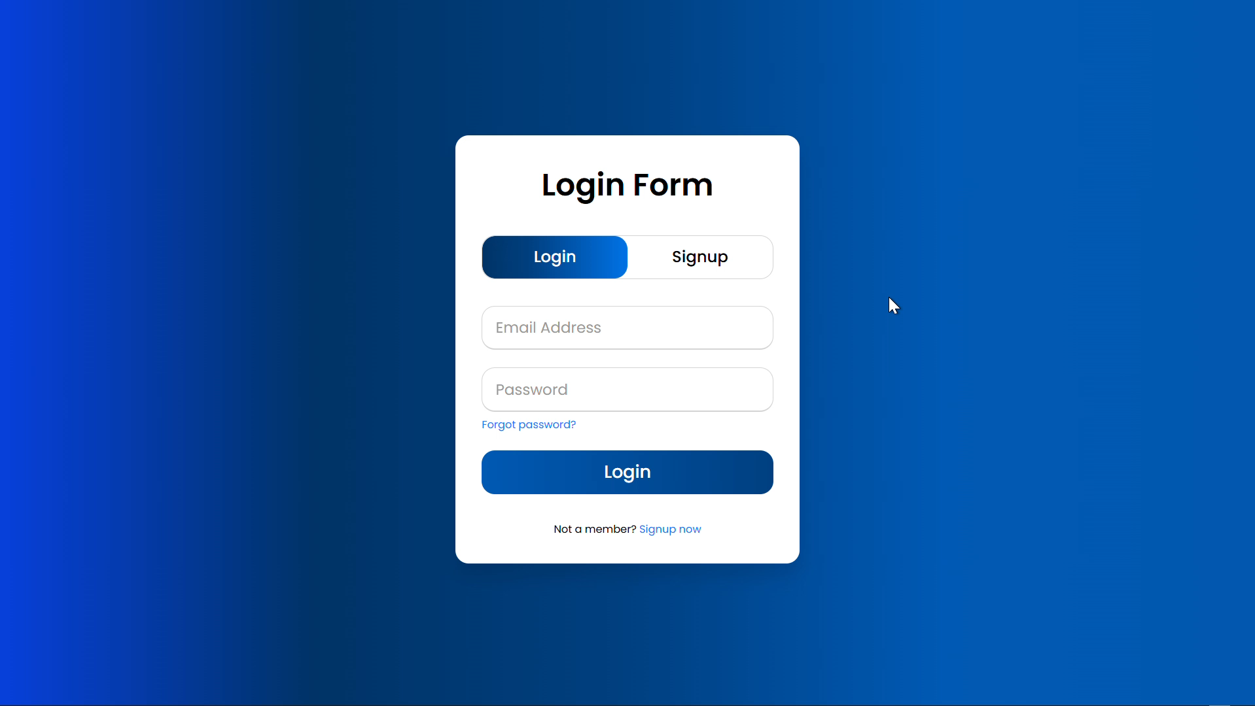

Slide 17
TIMELINE
AUG 2024 | LOGIN PAGE
SEP 2024 | LANDING PAGE
OCT 2024 | Proper Functioning of login page And landing page
NOV 2024 | MAIN PAGE
NOV 2024 | Implementation of ReactJS and proper functioning of main page

Slide 18





references
Images :
Unsplash
REFRENTIAL SITE:
Sundown Studio
Magma
ANIMATIONS :
GSAP
Locomotive Scroll
GENERAL :
W3Schools JS

Slide 19
references
Fonts:
Google Fonts
Background Videos:
Magma Video
Magma Video 2

Slide 20
An investment in knowledge pays the best interest
“
”
~Benjamin Franklin

Slide 21
THANK YOU
PROJECT GROUP 10
GitHub Link: Dhanadhyaksh

